Slide 1
Molecular biology of the cell

Slide 2
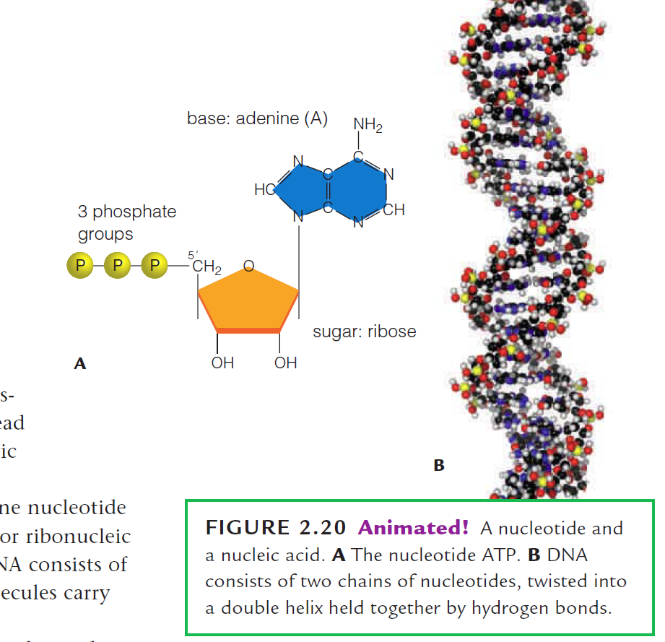
Nucleotide
Energy carriers
Enzyme helpers
Chemical messengers
Subunits of DNA and RNA

Slide 3
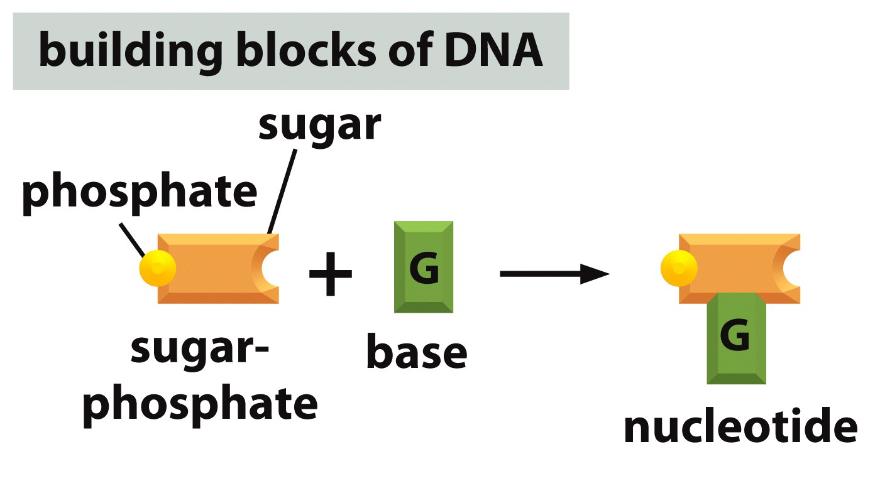
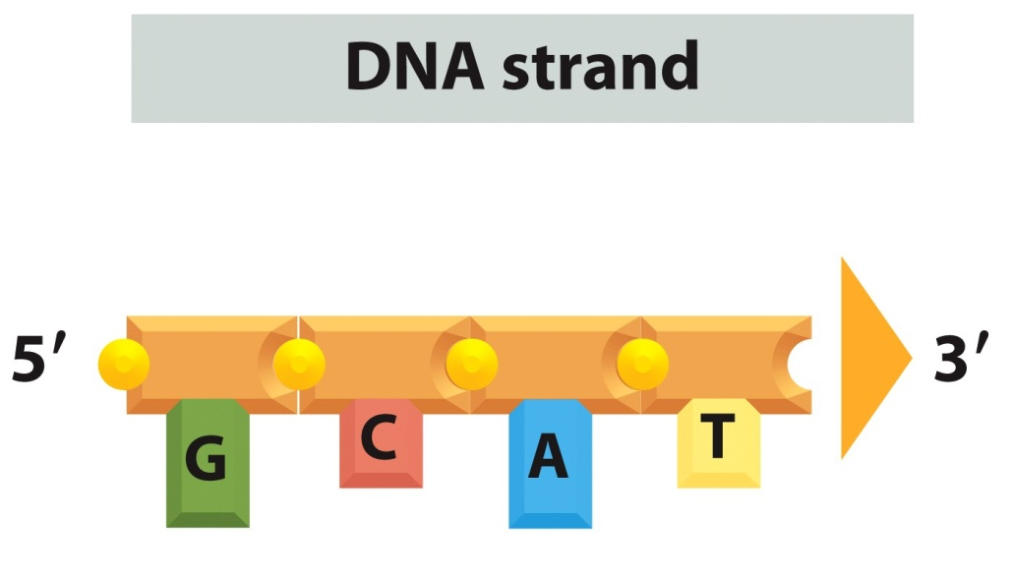
Nucleotide to DNA
A: Adenine
G: Guanine
T: Thymine
C: Cytosine
Figure 5-2a Essential Cell Biology (© Garland Science 2010)

Slide 4
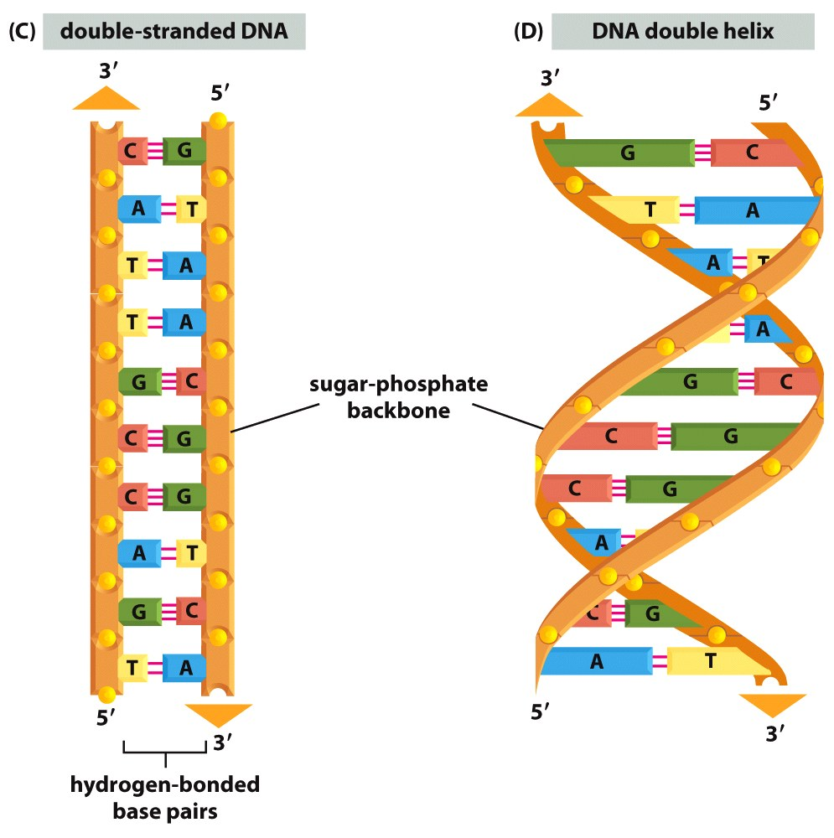
Double stranded DNA and DNA double helix

Slide 5
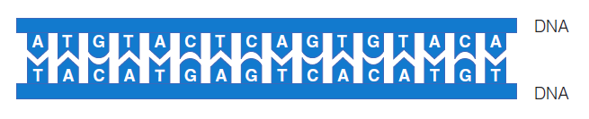
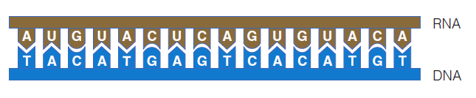
DNA to RNA: Transcription
Transcription
Same base pairing complementarity is maintained except U is incorporated in place of T.

Slide 6
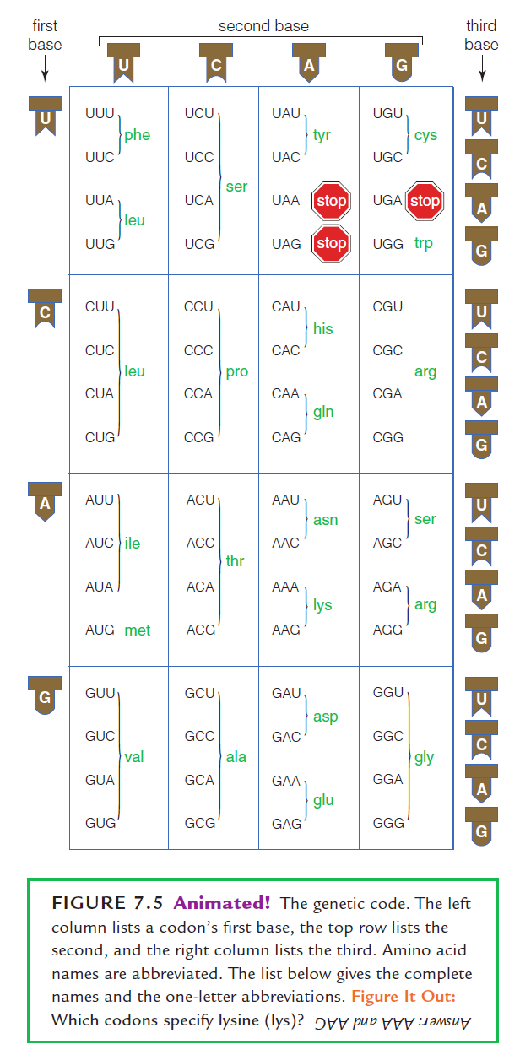
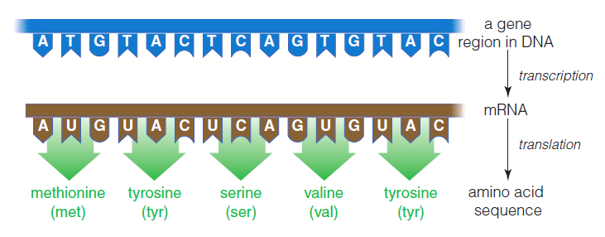
RNA to Protein: Translation

Slide 7
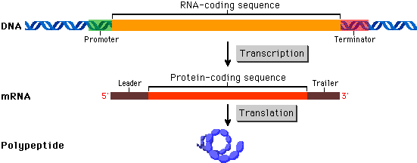
Gene
A gene is the basic physical and functional unit of heredity. Genes are made up of DNA. Some genes act as instructions to make molecules called proteins. However, many genes do not code for proteins. In humans, genes vary in size from a few hundred DNA bases to more than 2 million bases.

Slide 8
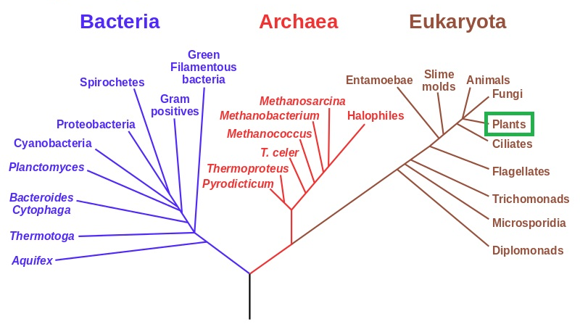
Genome
Genome:
A genome is an organism's complete set of DNA, including all of its genes. Each genome contains all of the information needed to build and maintain that organism.
Universal phylogenetic tree of life
Genome size of some of the organisms and human
E. coli 4.6 Mb
Yeast 12.1 MB
Drosophila 130 MB
Mouse 3 GB
Human 3.2 GB

Slide 9
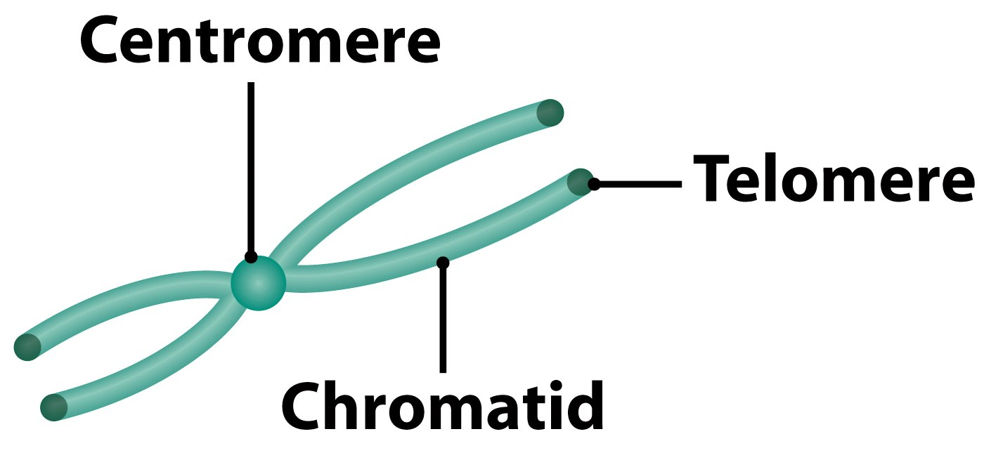
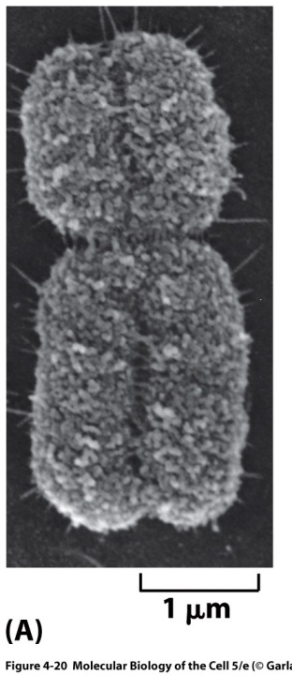
Eukaryotic Nuclear Genome
Set of DNA molecules each contained in chromosomes
Linear DNA
At least 2 chromosomes
Lots of space in between
Genes
Packaged in well defines nucleosomes.
Higher level of packaging generates chromatin.
Mitotic chromosome

Slide 10
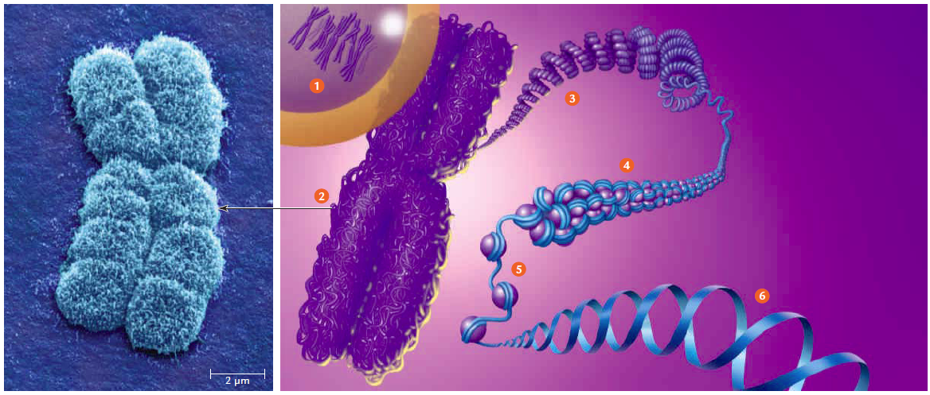
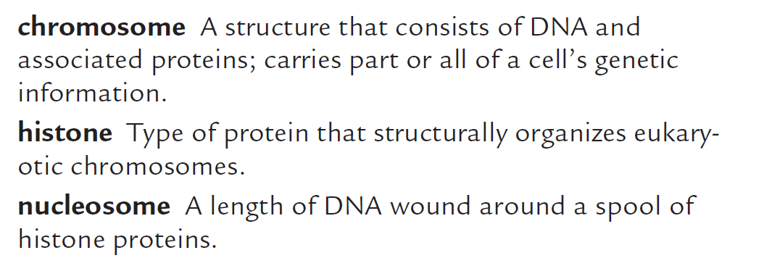
DNA is organized in chromosome
2 miters
to
10 micron

Slide 11
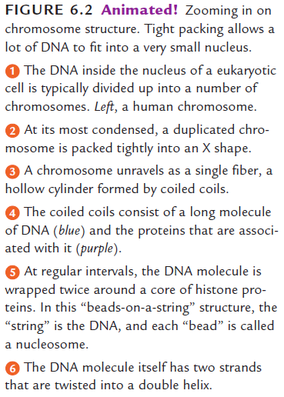
DNA is organized in chromosome

Slide 12
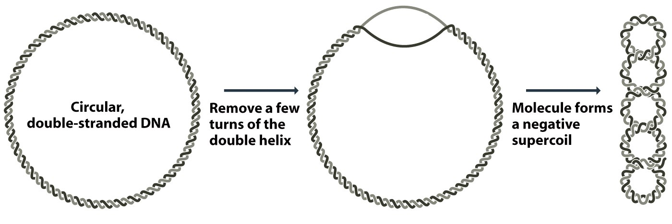
Supercoiling is a good way of packaging of
E. coli genome
Reduced turns Negative super coiling
Additional turns Positive super coiling
Figure 8.2 Genomes 3 (© Garland Science 2007)

Slide 13
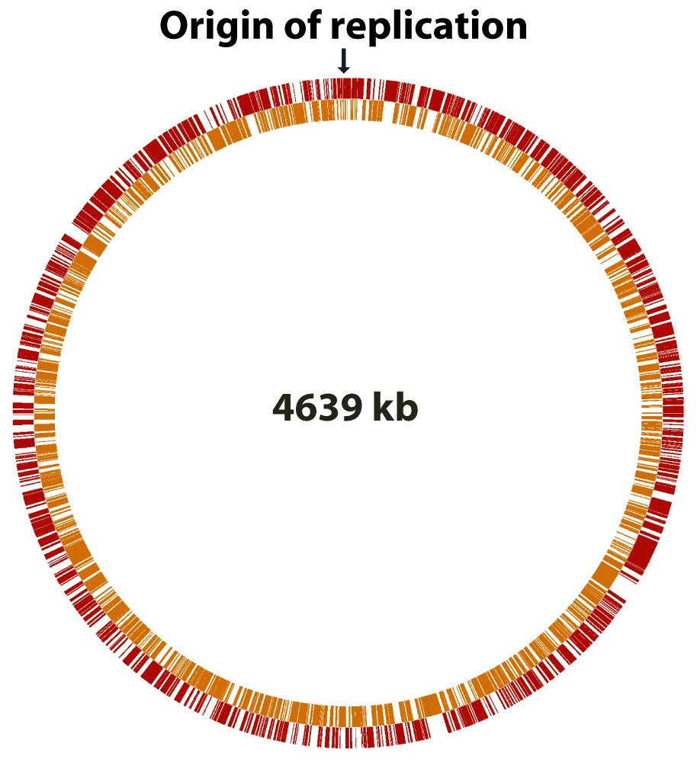
Bacterial genome has compact organization with very little space between the genes
It is possible that such compactness is required to replicate the genome quickly.
Bacteria can have circular or linear chromosome

Slide 14
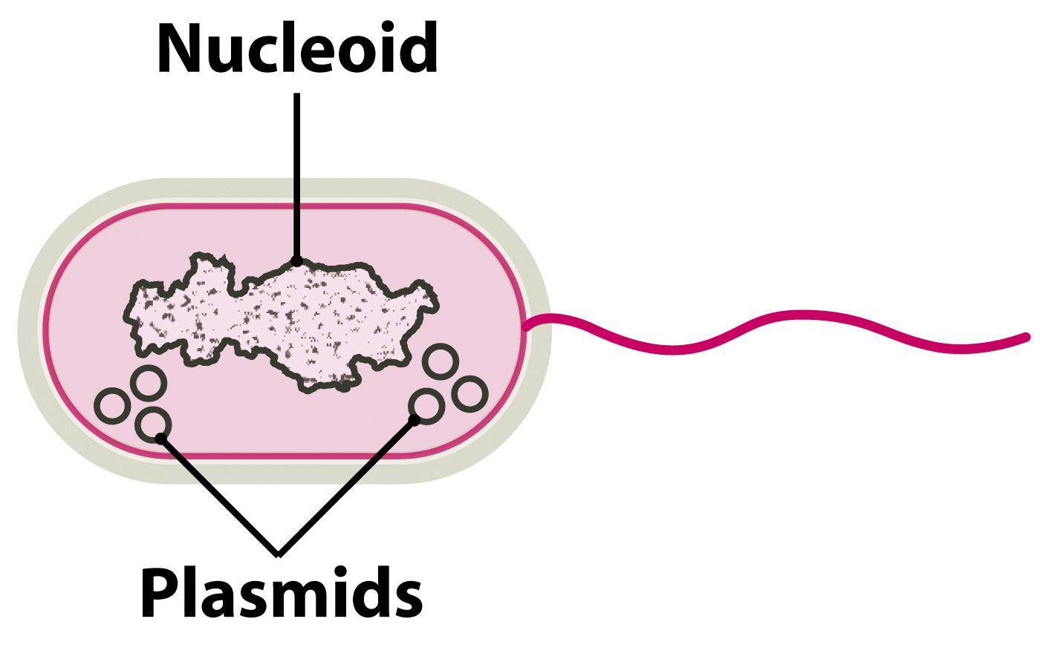
E. coli genome organization
E.coli chromosomes have about 4.7 x 10⁶ base pairs which results in a length of 1.6 mm. An E.coli cell, however is only 0.002 mm long . That explains why the DNA must be folded in order to fit into the cell.
Figure 8.5 Genomes 3 (© Garland Science 2007)

Slide 15
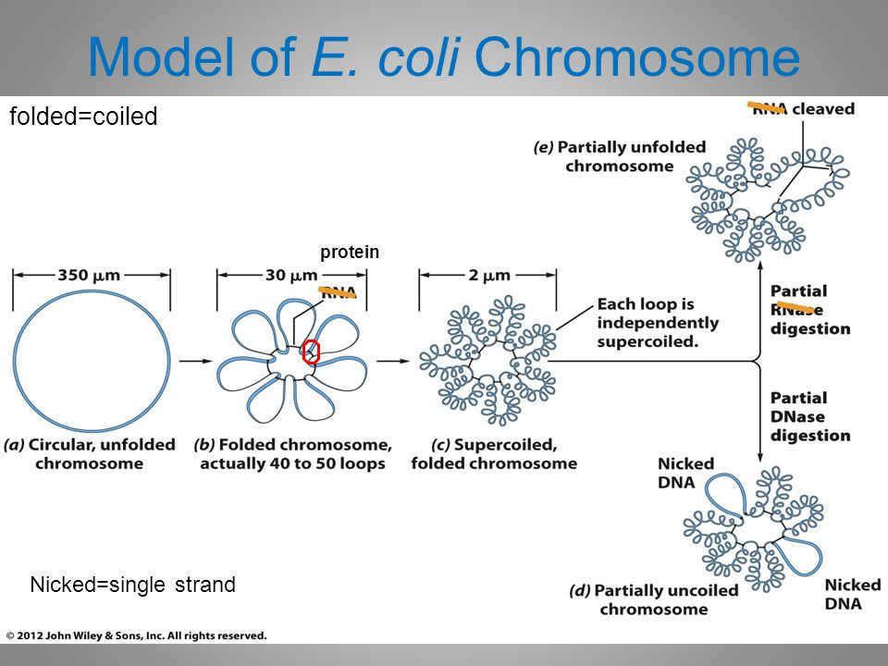
Bacterial genome undergoes simple and minimal packaging
E. coli genome nucleoid structure
Protein core

Slide 16
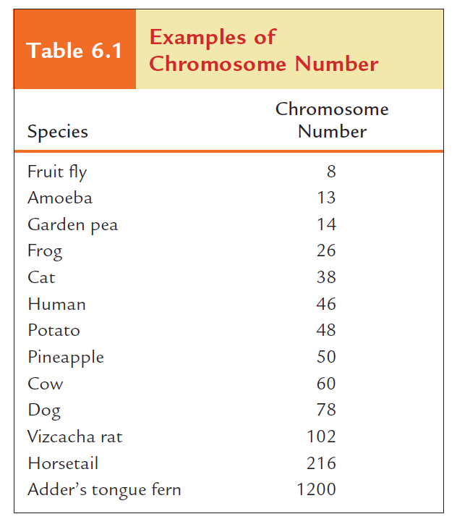
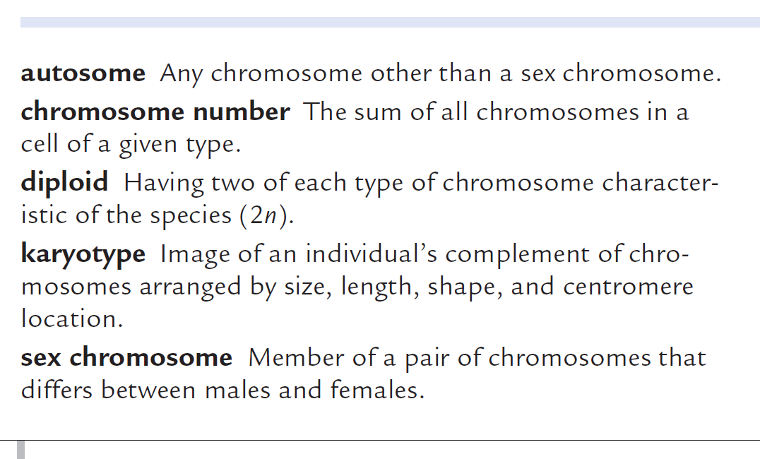
Chromosome number and types

Slide 17
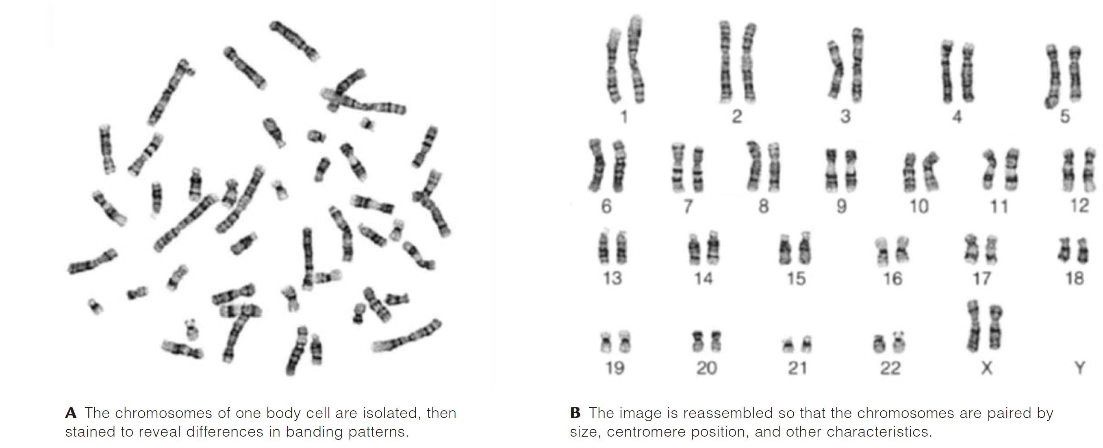
Karyotyping reveals an individual’s diploid complement of chromosomes

Slide 18
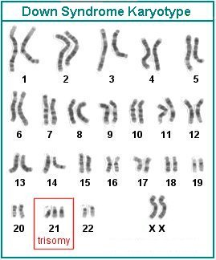
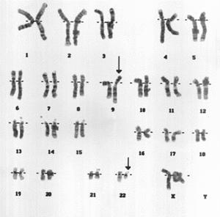
Myelogenous leukemia
Philadelphia Chromosome - CML

Slide 19
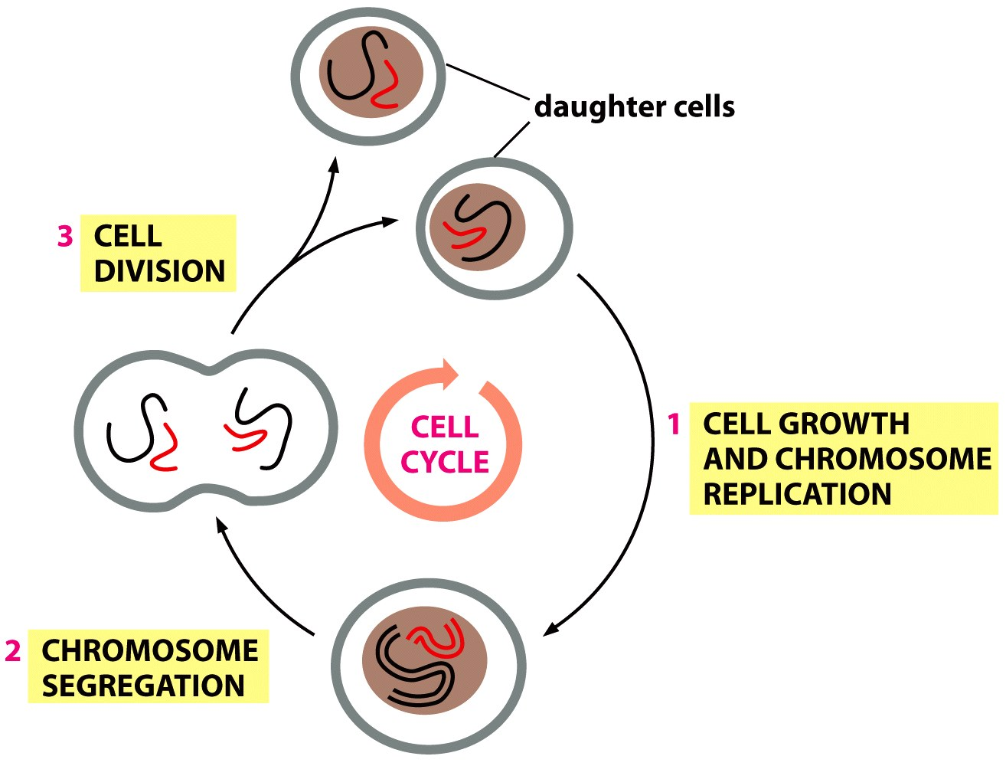
The eukaryotic cell cycle

Slide 20
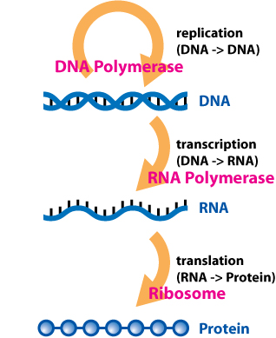
Storage and transfer of genetic information
Central dogma of transfer of genetic information
https://en.wikipedia.org/wiki/Central_dogma_of_molecular_biology

Slide 21
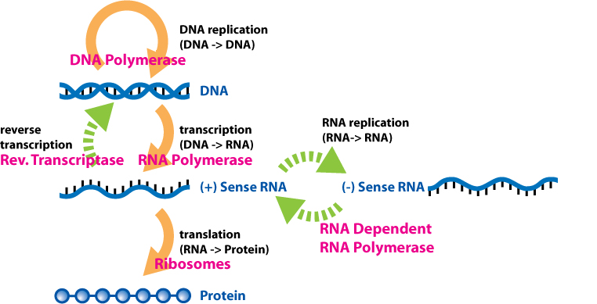
Updated central dogma
(HIV)
https://en.wikipedia.org/wiki/Central_dogma_of_molecular_biology

Slide 22
Replication

Slide 23
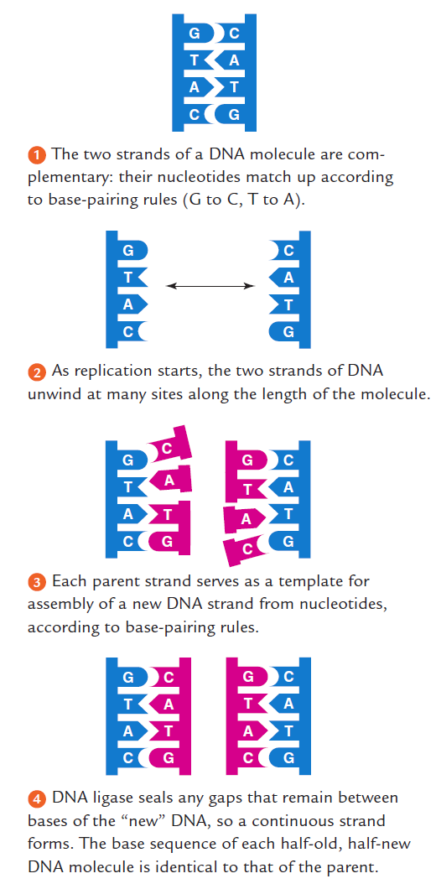
DNA replication
DNA replication:
Each strand of a DNA double helix is copied; two double-stranded DNA molecules result.

Slide 24
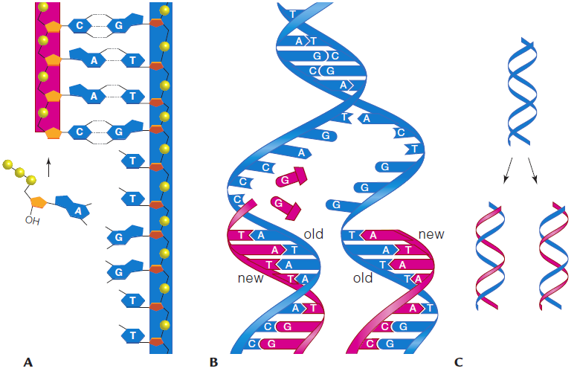
DNA polymerase moves 5’ to 3’ direction on the growing strand incorporating new nucleotides
5’
3’
DNA pol moves 5’ to 3’ direction
DNA Pol
DNA polymerase (DNA Pol) adds a deoxyribonucleotide to the 3ʹ end of a growing DNA chain
5’
How a double-stranded molecule of DNA is replicated. A DNA polymerase uses a parental DNA strand as a template to assemble a new strand of DNA from nucleotides. B The two parental DNA strands (blue) stay intact. A new strand (magenta) is assembled on each of the parental (old) strands. C One strand of each DNA molecule that forms is new, and the other is parental.

Slide 25
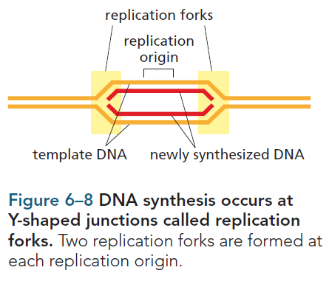
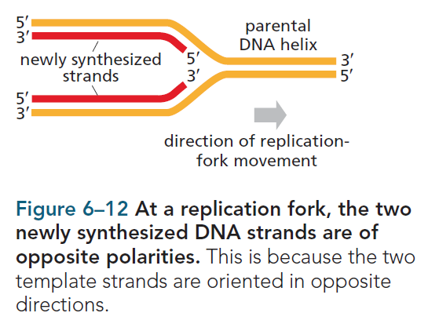
DNA polymerase complexes moves in two opposite directions from the origin of replication

Slide 26
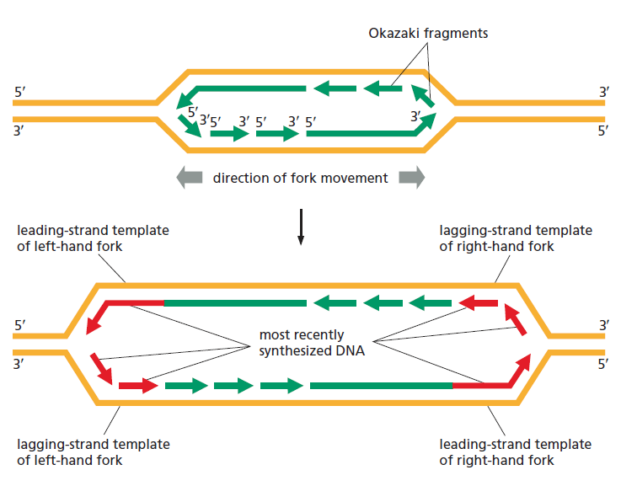
Lagging DNA strands and Okazaki fragments

Slide 27
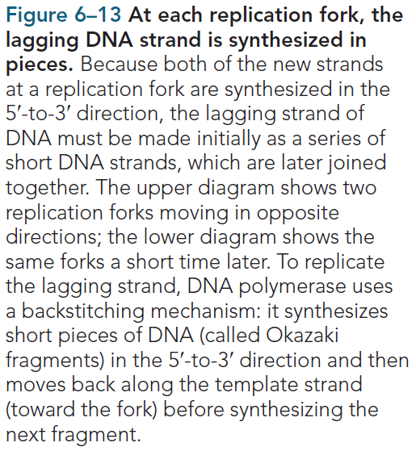

Slide 28
Checking for Mistakes: DNA repair
Radiation and toxic chemicals damaged DNA
Mistaking in copying damaged DNA
DNA repair machinery repairs the mistake

Slide 29
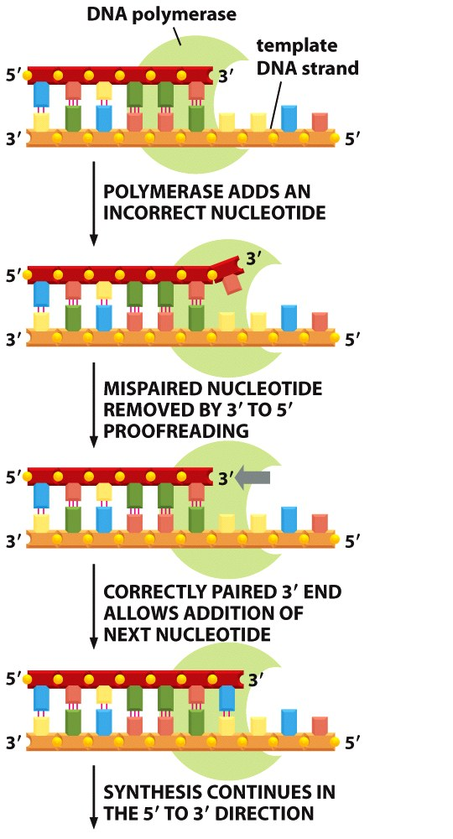
Checking for Mistakes: DNA proofreading
Mistake can be incorporated by DNA Pol as it is adding up to 1000 bases / sec
It is corrected by proofreading activity of the same molecule of DNA Pol

Slide 30
Mutation
When proofreading and repair mechanisms fail, an error becomes a mutation—a permanent change in the DNA sequence.
Mutations can alter DNA’s genetic instructions, and the outcome may or may not be harmful.
Mutations are the original source of variations in traits—the raw material of evolution.

Slide 31
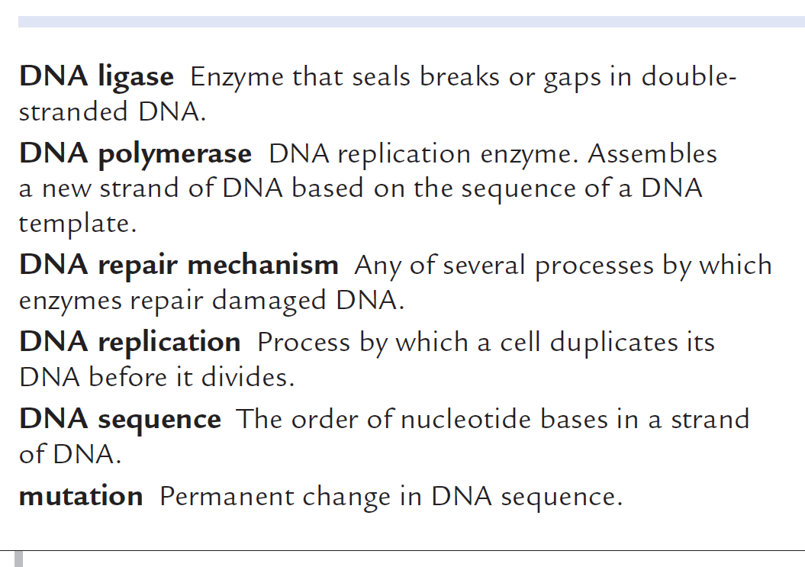
https://www.youtube.com/watch?v=9kp9wiYMQUU

Slide 32
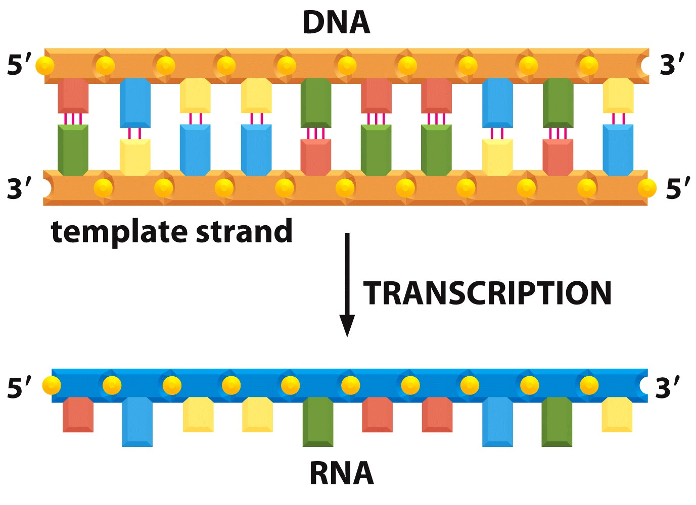
Transcription
https://www.youtube.com/watch?v=8_f-8ISZ164

Slide 33
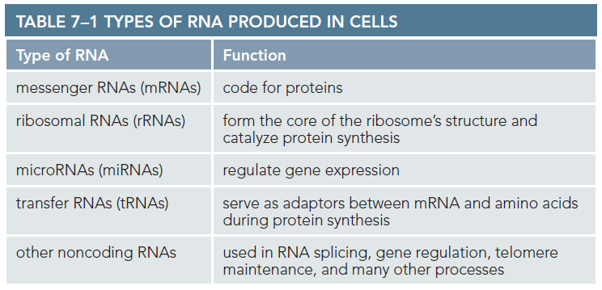

Slide 34
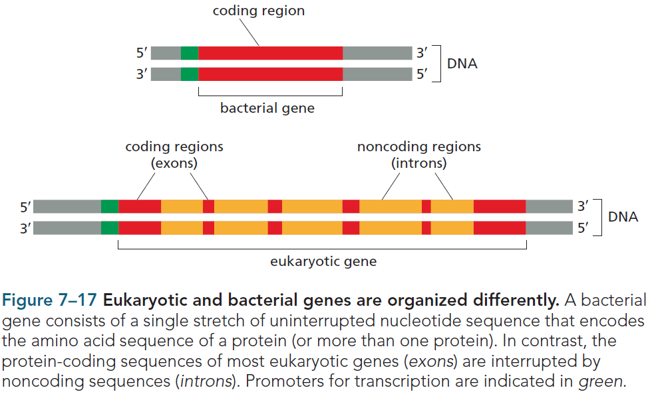
Prokaryotes and eukaryotes have different gene organization

Slide 35
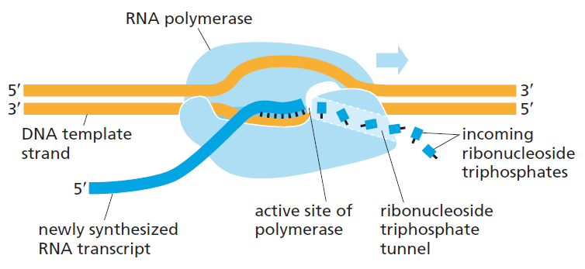
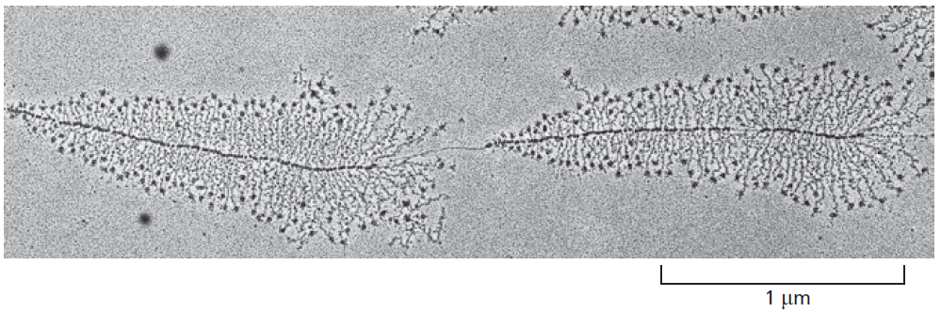
DNA is transcribed into RNA
by the enzyme RNA polymerase
The electronmicrograph shows many molecules of RNA polymerase simultaneously transcribing two adjacent ribosomal genes on a single DNA molecule. Molecules of RNA polymerase are barely visible as a series of tiny dots along the spine of the DNA molecule; each polymerase has an RNA transcript (a short, fine thread) radiating from it.

Slide 36
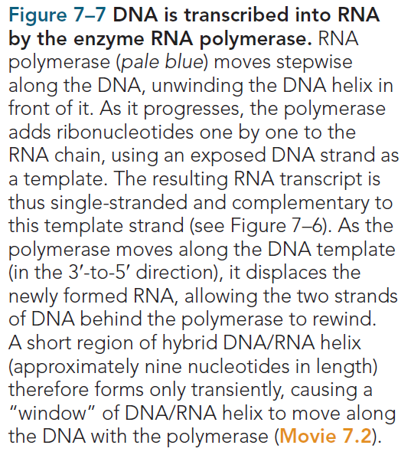

Slide 37
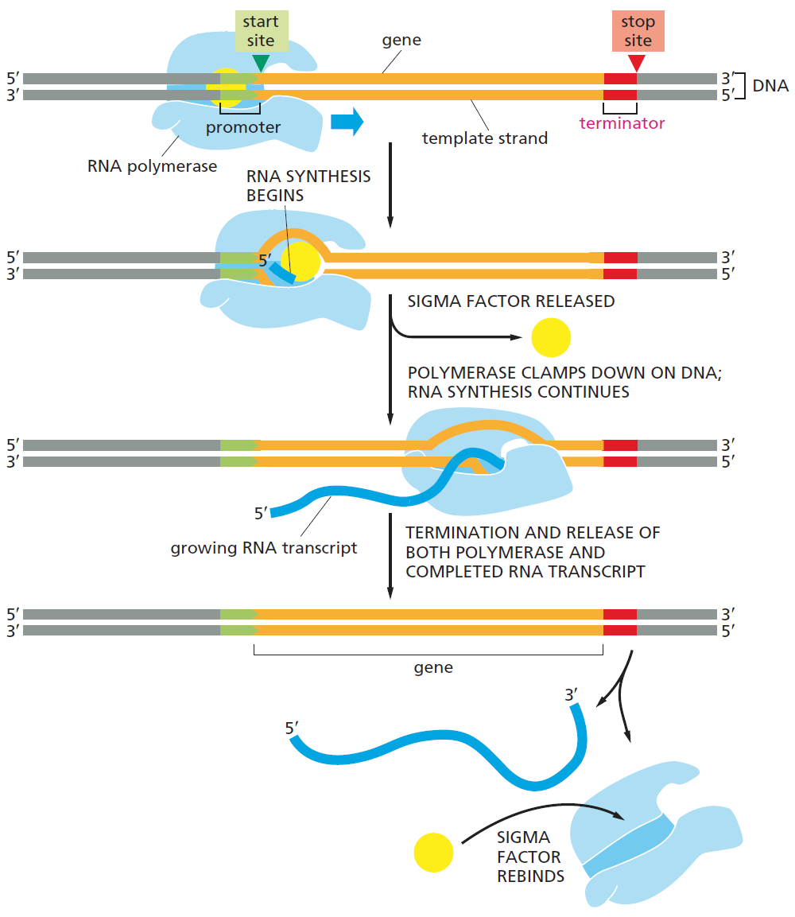
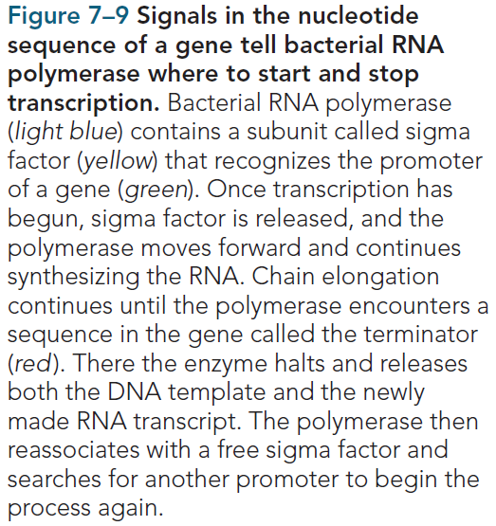
Promoter, start site and stop sequences

Slide 38
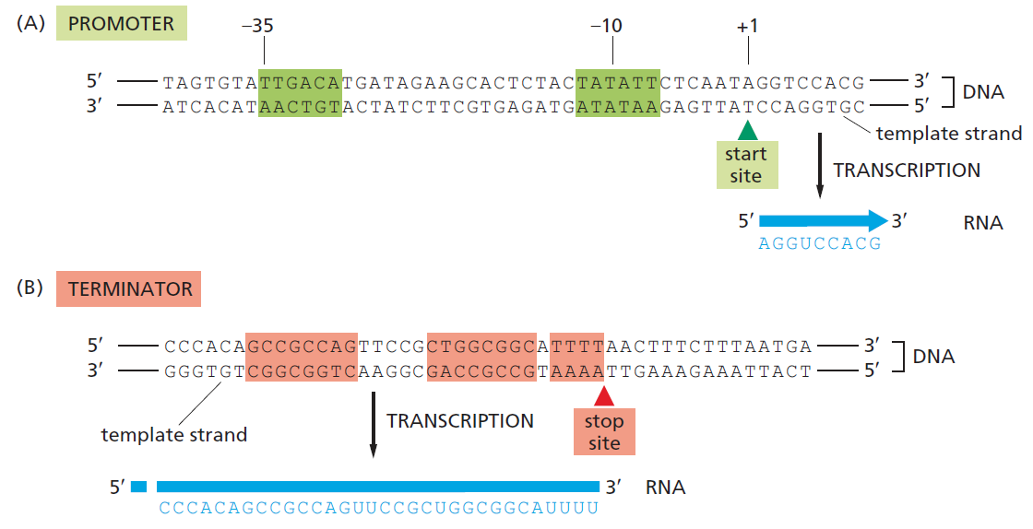
Promoters and terminators have specific
nucleotide sequences that are recognized by RNA polymerase

Slide 39
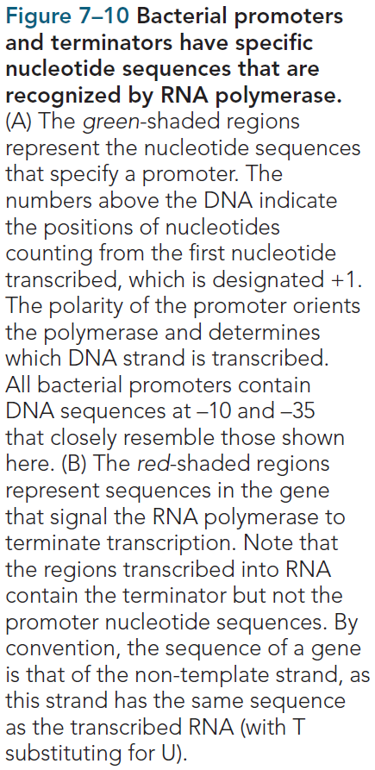

Slide 40
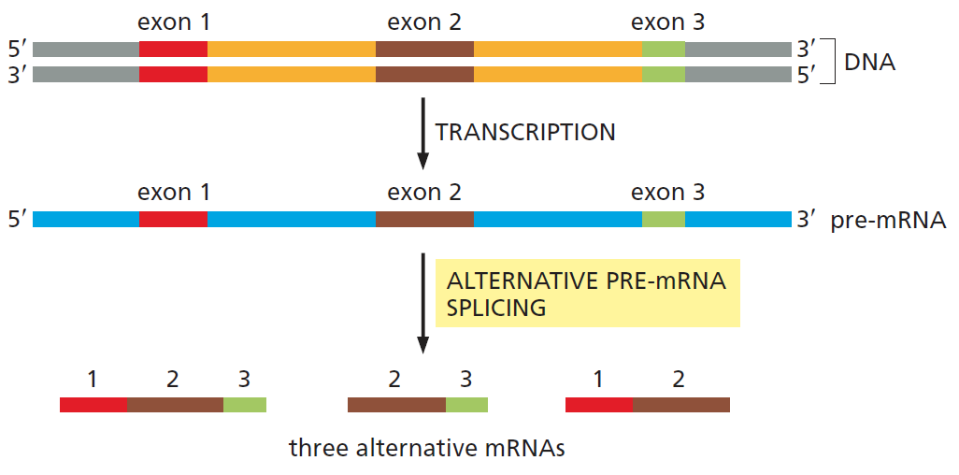
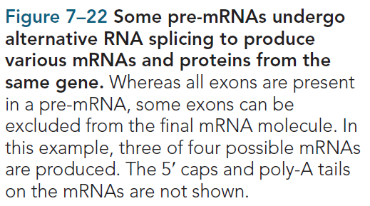
Eukaryotes can generate different mRNA from the same gene by alternate splicing of pre-mRNA

Slide 41
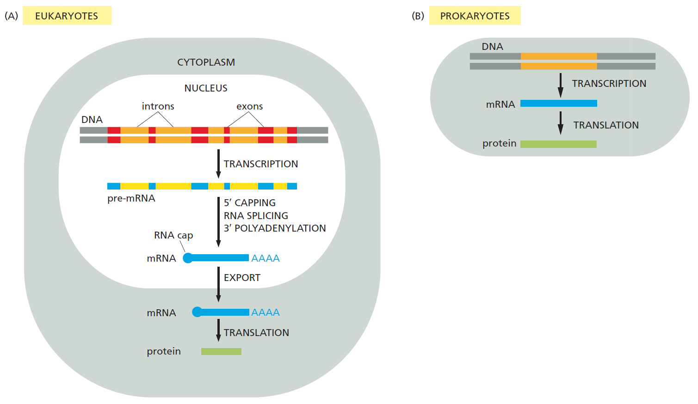
Prokaryotes and eukaryotes handle their RNA transcripts differently
https://www.youtube.com/watch?v=aVgwr0QpYNE
https://www.youtube.com/watch?v=_Zyb8bpGMR0
https://www.youtube.com/watch?v=8_f-8ISZ164

Slide 42
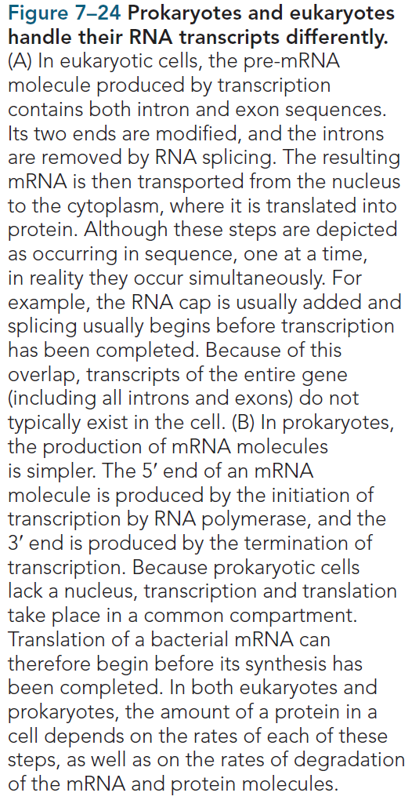

Slide 43
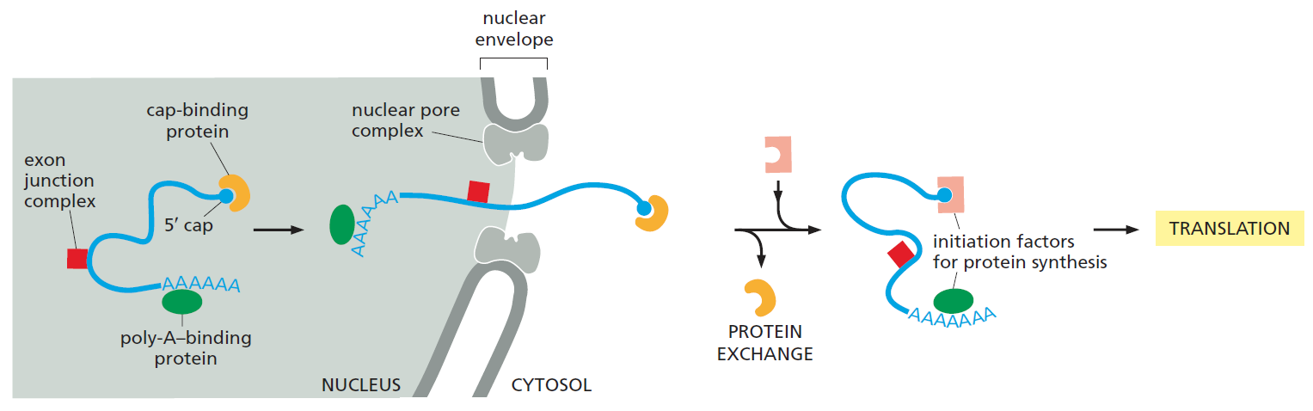
Mature mRNAs are exported out of nucleus into cytoplasm for protein synthesis
Mature mRNAs are exported out of nucleus through nuclear pore with the help of some associated protein into cytoplasm for protein synthesis. In the cytosol, the
mRNA can shed some of these proteins and bind new ones and ribosomes for protein synthesis.

Slide 44


Translaton: protein synthesis
Prokaryotes: Protein synthesis happens in cytoplasm
Eukaryotes: Protein synthesis happens in cytoplasm and on rough ER

Slide 45

mRNA is red by the ribosome using genetic code

Slide 46


Genetic code is read with the help of tRNA

Slide 47

The genetic code is translated by the cooperation of two adaptors: aminoacyl-tRNA synthetases and tRNAs.
Each synthetase couples a particular amino acid to its corresponding tRNAs, a process called charging. The anticodon on the charged tRNA molecule then forms base pairs with the appropriate codon on the mRNA. An error in either the charging step or the binding of the charged tRNA to its codon will cause the wrong amino acid to be incorporated into a protein chain. In the sequence of events shown, the amino acid tryptophan (Trp) is selected by the codon UGG on the mRNA.

Slide 48


Ribosome: the protein synthesis machine

Slide 49



Ribosome slides along the mRNA 5’-3’ direction polymerizing amino acids one after another
With the formation of a new peptide bond the growing chain of amino acid is transferred to the last tRNA.
The empty previous tRNA leaves.
Next tRNA loaded with the next amino acid comes in and forms a new peptide bod.
The cycle continues till ribosome hits a stop codon.
A
B
C
D
E
F

Slide 50

Multiple ribosome are loaded on the same mRNA molecule simultaneously producing multiple copies of the coded protein

Slide 51


Mutation in genetic code

Slide 52


Differential gene expression

Slide 53
Some videos for reference:
DNA structure :https://www.youtube.com/watch?v=o_-6JXLYS-k&t=222s
DNA packaging : https://www.youtube.com/watch?v=gbSIBhFwQ4s
DNA supercoiling: https://www.youtube.com/watch?v=5hwaDamU-jo&t=152s
The central dogma: https://www.youtube.com/watch?v=whV_CkKT7F0
DNA replication : https://www.youtube.com/watch?v=TNKWgcFPHqw
DNA transcription/translation :https://www.youtube.com/watch?v=8_f-8ISZ164&t=361s

